Slide 1
Lecture 2
Intro. To Software Engineering and Object-Oriented Programming
(1/2)
Bong-Soo Sohn
Chung-Ang University

Slide 2
What is a Good Program?
(Factors of Good Software)

Slide 3
Software Crisis
rapid increases in computer power and the complexity of the problems (SW).
Software technology can not follow the complexity.
the difficulty of writing correct, understandable, and verifiable computer programs
SW Symptoms
  Unmanageable
  difficult to maintain
  Over-budget.
  Over-time (late)
  Poor quality
  Software often did not meet requirements.
Cause : complexity

Slide 4
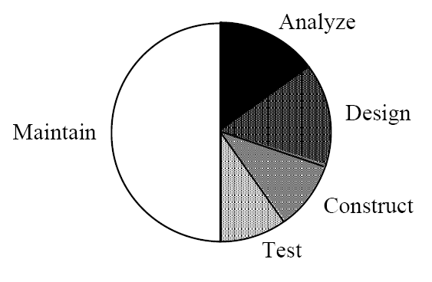
Software Life Cycle
Requirement Analysis
  Problem specification
Design
  Program structure
  Module specification
Implementation
Test
  unit test
  integration test
Maintenance
Fred Brooks states that over 90% of the costs of a typical system arise in the maintenance phase, and that any successful piece of software will inevitably be maintained.

Slide 5
Software Engineering
Definition
  [IEEE Definition] The application of a systematic, disciplined, quantifiable approach to the development, operation, and maintenance of software
  , that is, application of engineering to software
  [Firtz Bauer] The establishment and use of sound engineering principles in order to economically obtain software that is reliable and works efficiently
Goals
  produce a correct, efficient, and reliable software
  minimize the cost of software development and maintenance

Slide 6
Goals of SE
Maintainability
  the ability to easily make changes, enhancements, or improvements.
Dependability
  the ability to rely on the software to function properly when needed.
Efficiency
  the ability for software to use computing resources effectively (mainly space and time).
Usability
  the ability for the end user to easily and effectively put the software to proper use.

Slide 7
Software Properties
Modularity – divide and conquer.
Encapsulation – hide the implementation.
Localization – collect similar things together.
Abstraction – simplifying complex reality.
Uniformity – make everything look similar.
Completeness – do everything required.
Confirmability – be able to prove that the software works properly.

Slide 8
Programming Methodology
Unstructured Programming
Procedural Programming
Modular(Structured) Programming
Object Oriented Programming

Slide 9
Unstructured Programming
Consists of only one main program.
a sequence of commands or statements
Only global data
Use goto statement
Disadvantage
  If there is the same statement sequence?

Slide 10
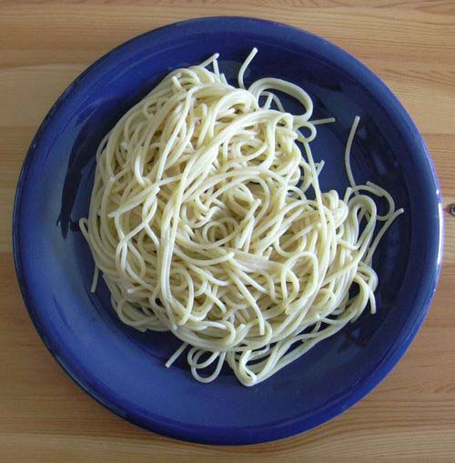
Spaghetti Code
Code with complex and tangled structure
  With goto’s jumping all over the place
  Almost impossible to understand
  Hard to follow the flow
  Difficult to modify

Slide 11
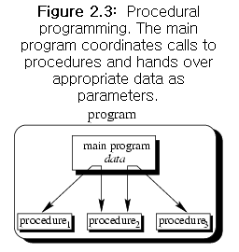
Procedural Programming
The abuses of spaghetti code led to structured programming languages to support procedural programming
Program
  A sequence of procedure calls
Procedure
  the same seqeunce of statements
More structured : reduce repetition
More error-free
Structured Programming
  Top-down approach
  Divide and conquer
  Functional decomposition

Slide 12
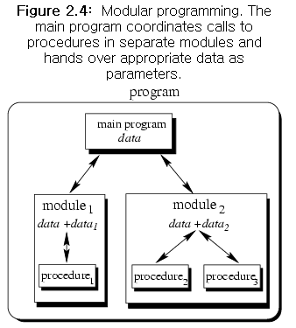
Modular Programming
SW is composed of separate parts (module)
procedures of a common functionality are grouped together into separate modules
module
  Program uses modules through interface.
  Interface : visible, implementation : hidden
  Improve maintainability

Slide 13
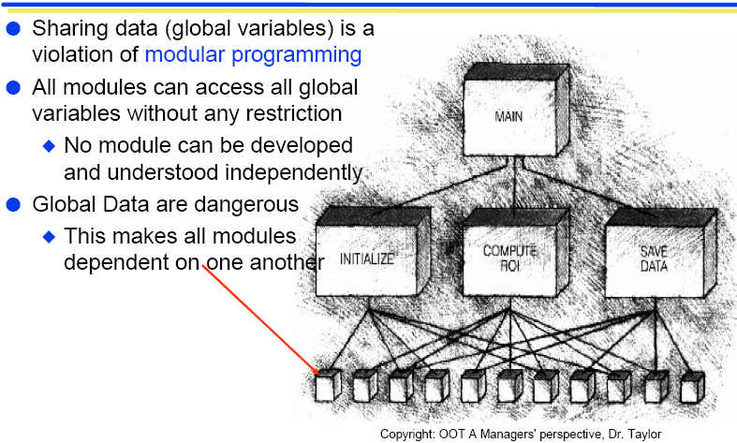
Don’t use Global Variables
Using global variables : unsafe!

Slide 14
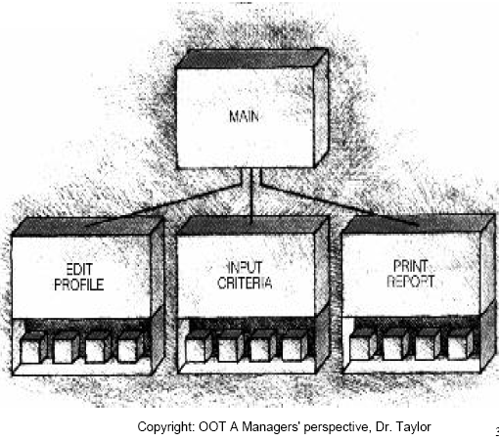
Modularized Data
Localize data inside the modules
This makes modules more independent of one another
Safe!
Local data

Slide 15
Problems of
Procedural/Modular Programming
Decoupled (seperation of) data and operations
Doesn’t work well in large systems
  Difficult to debug, extend, and maintain
  Code reuse limited
Explicit creation and destruction
Many others compared to OOP

Slide 16
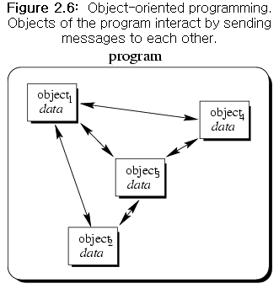
OOP (Object Oriented Programming)
Program consists of a set of interacting objects.
Each object keeps its own state.
Combine data and operation into an object

Slide 17
What is an Object?
Object is an instance of a class
Objects have
  identity
  attribute
  behavior (method)
  relationships with other objects

Slide 18
Structured Programming vs OOP
Structured
Programming
Car, Book, Apple, Ship
ride
eat
read
operate
Car
Apple
Book
Ship
OOP
ride
eat
read
operate

Slide 19
Structured Programming vs OOP
Procedural
Programming
data + function = program
object
data
data
+
function
=
function
OOP
object + object = program

Slide 20
Views of OOP
  OOP does not consider the problem domain as just a flow of processings.
  OOP defines objects related to the problem domain and regards these objects communicate information each other (through message passing).
  On the other hand, structured programming treats data and operations independently even though they are related.

Slide 21
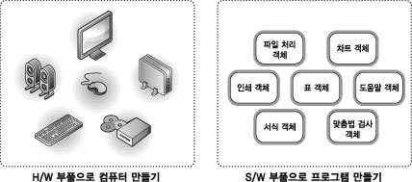
Software Components(부품화)
In OO programs, an object works as a component(부품) of software
Interface of an object should be well defined.

Slide 22
Why Object Oriented?
Good for developing large software
Maintainability
Reuse software, not rewrite
Increase
  Programmer productivity
  Quality of software
  Understandability of software
  Scalability (extensibility,reusability) of software
  Lifetime (maintainability) of software

Slide 23
OOP
What is problem?
  Traditional structured programming is not sufficient for large software maintenance and reuse.
Solution? OOP
  Improve reusability
  SW reliability is increased using reusable modules which are already well-tested and error-free .

Slide 24
OOP concepts
Data Abstraction
  Abstract Data Type
Object
  Information hiding/encapsulation
Class
Inheritance
Polymorphism
Dynamic binding

Slide 25
ADT(Abstract Data Type)
A set of data variables and associated operations that are precisely specified independent of any particular implementation.
ADT = data + operations (no implementation)
In OOP,
  We don’t define data for defining procedures,
  But we do define procedures necessary for defining data
  ADT is a type that combines data and the procedures

Slide 26
class
In C++, “class” is used for defining ADT
Defines attributes and behaviors of an object
  Attributes : member variables
  Behaviors : member functions

Slide 27
Object
Object is an instance of class
Consists of
  Internal data
  Internal operations
  Interface operations
Only class methods can access the internal data of an object.
Message passing
  Request some work to other object through calling a method.

Slide 28
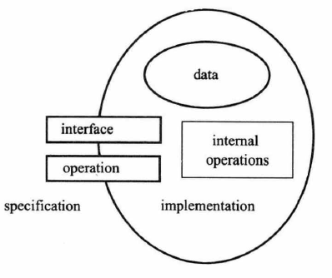
Object Overview

Slide 29
Information Hiding/Encapsulation
Encapsulation conceals the functional details of a class from objects that send messages to it.
Internal data of an object can be modified only through an interface

Slide 30
Class vs Object
Each object generated by the same class is different objects
  When the objects are created, different memory space and address are assigned to each object with unique identifier.
Objects created by the same class share the class’s methods.
An object can be dynamically constructed or destructed in memory during run-time.

Slide 31
Inheritance
A child class (Sub class) inherits attributes and behaviors of parent classes (super class).
and can define their own attributes and behaviors.
The properties (variables,methods) of a child class should be mostly similar to the properties of parent classes.
Goal : Object (class) Reuse
In large SW development, code reuse reduces costs.
We can reuse well-defined classes.
Related programs can define new classes using inheritance.

Slide 32
Polymorphism
Allows the same method (message) to different meaning.
the ability of objects belonging to different data types to respond to method calls of the same name, each one according to an appropriate type-specific behavior.
In C++
  Virtual function
  Operator overloading
  Function overloading
  Template

Slide 33
Benefits of Object Model
Builds a system that evolves over time
  Entendible
  Stable
Thinking in terms of objects and classes is much easier for humans
Separating the client and implementor prevents accidental damage through data encapsulation
Reusability

Slide 34
보충 자료 (강의 페이지)
Handout 1: Factors of Good Software

Slide 35
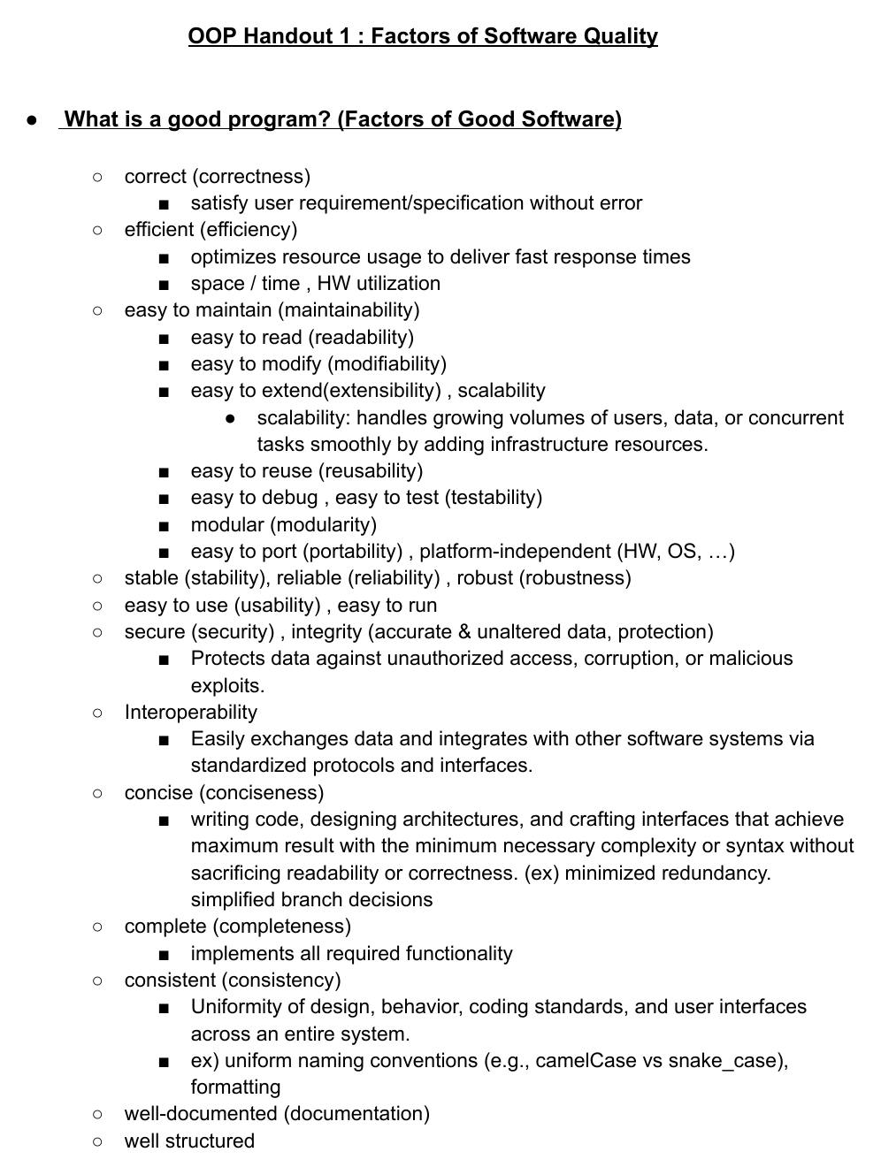
Handout 1: Factors of Good Software

